Slide 1
Table Worker Training
NVSL University – 31 May 2024
Jen Guernsey, presenter jenguernsey@gmail.com

Slide 2
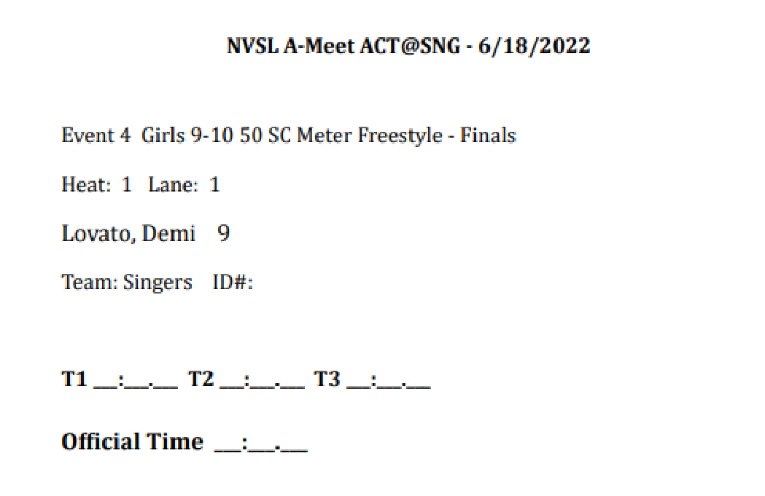
Goals of “The Table”
Accurately enter the official time from the timecards into HyTek Meet Manager
Capture scratches, substitutions, records, and
disqualifications
Score the meet
Produce awards
Official NVSL Timecard

Slide 3

Timecard Flow
1 timecard per swim lane per event = 6 cards per event
3 timers per swim lane = 3 times on each timecard
The Table
Runner
Timers Place Recorders (2)
Data Entry (2)
Announcer
(printed results)
Data Verifier (1)

Slide 4
Table Roles
The Ideal
2 Place Recorders – 1 from each team
Check times, names, DQ slips, place order
2 Data Entry – 1 from each team
Enter times/DQs, print results, print ribbon labels
2 Data Verifiers – can be anyone wandering by the table
Verify names, times, take results to announcer
2 Awards Clerks – 1 from each team
Stick labels on ribbons, sort by team
You can get by with
2 place recorders, 1 data entry, 1 verifier/awards clerk
But more checking is better!

Slide 5
Place Recorder Duties
Place Recorder #1
Ensures official time is legible and correct
If three different times: middle time
If double or triple: the doubled or tripled time
If just two times: average but round DOWN
Checks names against scratches/substitutions
Attaches DQ slips to FRONT of card
Sorts cards into FINISH order, DQs last
Clips cards and sends to Place Recorder #2
Place Recorder #2
Rechecks everything Place Recorder #1 did
Writes “DQ” in RED on upper right corner of DQ cards
Writes place number in upper right corner of cards
Sorts cards into LANE order
Reclips cards and sends to Data Entry

Slide 6
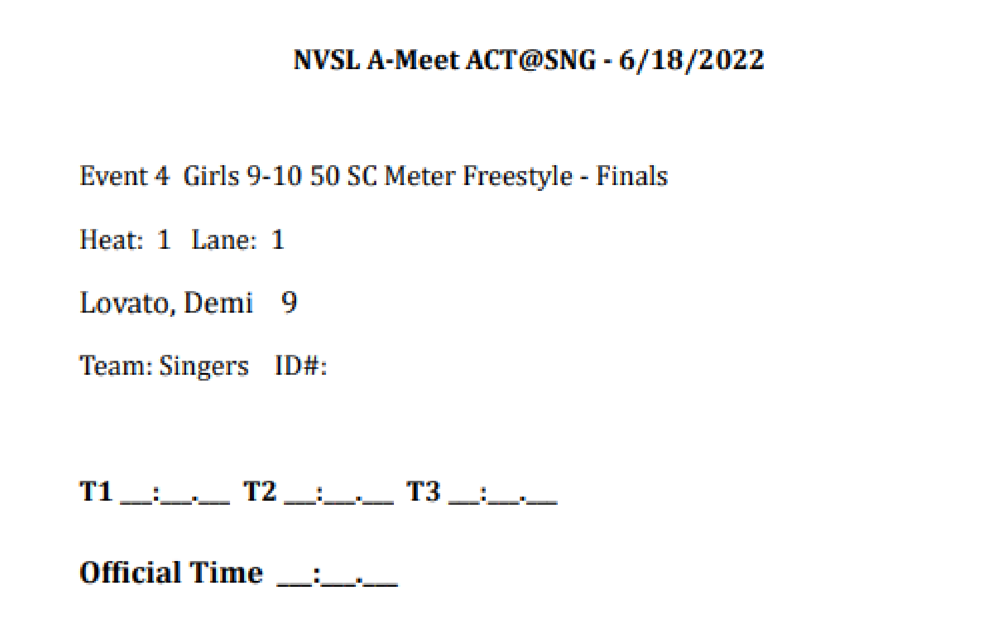
Completed Timecard
3
56.6 | Apply the common sense test to the times on the card. Are they all reasonably close to each other? Did an 8-year-old just break an NVSL record by 15 seconds? Did they write 52.2 or 57.2? If unsure, ask the chief timer!
56.6

Slide 7


Data Entry
Card Reader reads time from card (optional)
Laptop Operator enters time in the appropriate event/lane in Meet Manager
  Checks DQ box in Meet Manager, if needed
  Ensures swimmer scratches/substitutions have been made in Meet Manager
Laptop Operator reads times back to Card Reader, along with place finish, to catch data entry errors
Laptop Operator prints results for Data Verifier
Laptop Operator prints ribbon labels after every 10 events for the Awards Clerks

Slide 8
Data Verifiers
Receive timecards and printed results for each event, one event at a time
Put cards into finish order
Verify printed results match timecards
  Show any discrepancies to the data entry team and/or place recorders as appropriate
  Check for new records, note for announcer
Initial verified results sheet
Hand verified results sheet to announcer
Keep timecards until end of the meet

Slide 9
If there is a problem with…
The times on the time card
  Wrong time circled
  Math (averaging of two times) incorrect
  Illegible time
  Unrealistic time
Return to chief timer
A DQ slip
  Event/heat numbers don’t match up
  Lane number incorrect (e.g., empty lane)
  Slip not signed
  Return to referee

Slide 10
If there is a problem with…
  The name on the card
    Name doesn’t match scratch/substitution form
    → Return to chief timer
    Name on card has been changed but there is no scratch/substitution form
    Notify team rep that a scratch/substitution form is needed
    ***Return errors for correction ASAP!***
    ***The table RECORDS, the table DOES NOT FIX!***

Slide 11
New NVSL Records
***Special handling!***
Mark time card in red: NEW (or TIED) NVSL RECORD
Have card signed by Referee, Chief Timer, and all 3 Lane Timers (5 signatures total)
Make a copy of the time card (no signatures) marked in red: NVSL RECORD – DUPLICATE CARD
Keep copy with remaining time cards at table
Give original card to record setter’s Team Rep
Enter record in red in the Records section on the bottom of the official meet results cover sheet
Ensure announcer is apprised of new record
Note: Team records do NOT get special treatment

Slide 12
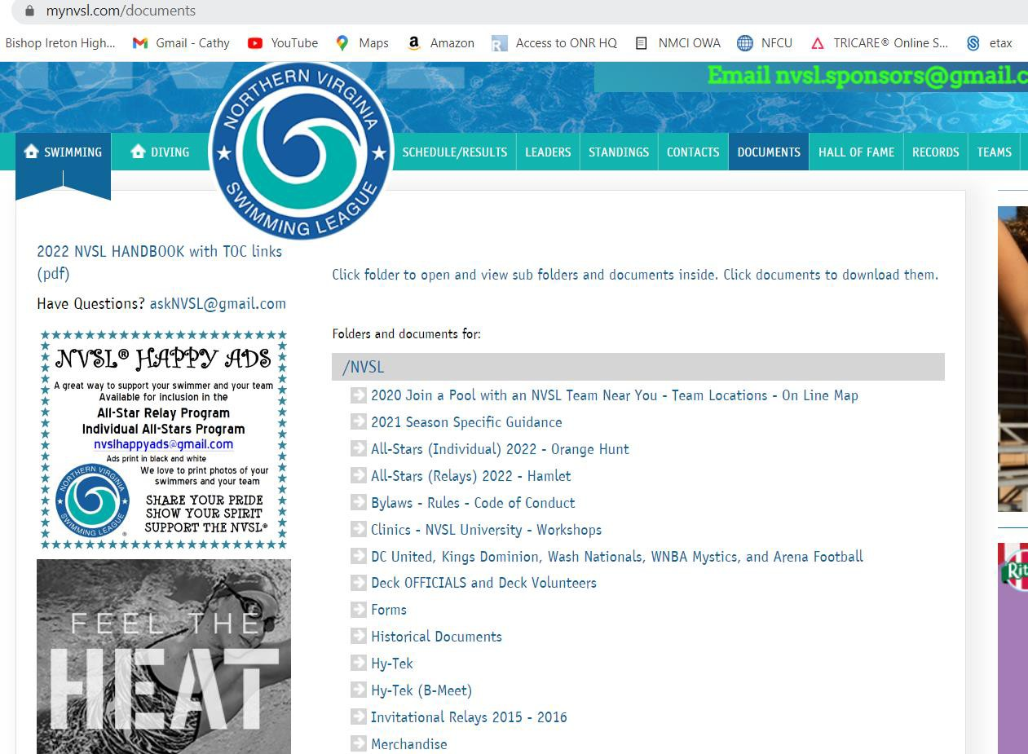
NVSL Website https://www.mynvsl.com/

Slide 13
https://www.mynvsl.com/documents?folder_id=28722

Slide 14

HOT TIPS
Know who’s got the table supplies
Set up the table: sharpen regular & red pencils, put out clips and bins for cards, fill stapler, provide ribbon receptacle for each team
Seating order: Place recorders closest to the timers, then data, then verifiers, then awards
Place recorders: Find out who the runner is, introduce yourselves, and show them where to put cards/DQ slips
DQs: Keep an eye/ear out for when a DQ is happening
Don’t rush to process for 8&U back or for any breast or fly…wait for the DQs
Stay on top of things so you can immediately bring issues to the attention of the ref or chief timer

Slide 15

Any Questions?

