Slide 1
HY-TEK Software Overview
Introduction to NVSL Technology
2024
Presenter: Jen Guernsey
jenguernsey@gmail.com
2024 Technology Committee
NVSLTechnology@gmail.com
Michelle Hale Bryan Harris Nancy Jessen
Sue Murphy Stephanie Curb Brian Pawlowicz

Slide 2
Outline
Introduction
Resources
Software overview
Getting started
Process overview
Tips & tricks

Slide 3
Outline
Introduction
Resources
Software overview
Getting started
Process overview
Tips & tricks

Slide 4
Navigating the NVSL Website
NVSL website: http://mynvsl.com
The website provides
  Basic league information
    Points of contact, calendar, schedules, records and announcements
  Meet results
    Scores, times, searchable leaders function, meet results files (team reps) and standings
  Important resources
    Meet template files, meet event files, procedures, training materials, clinic handouts and bylaws
  Team pages
    Announcements, calendar, documents and records

Slide 5
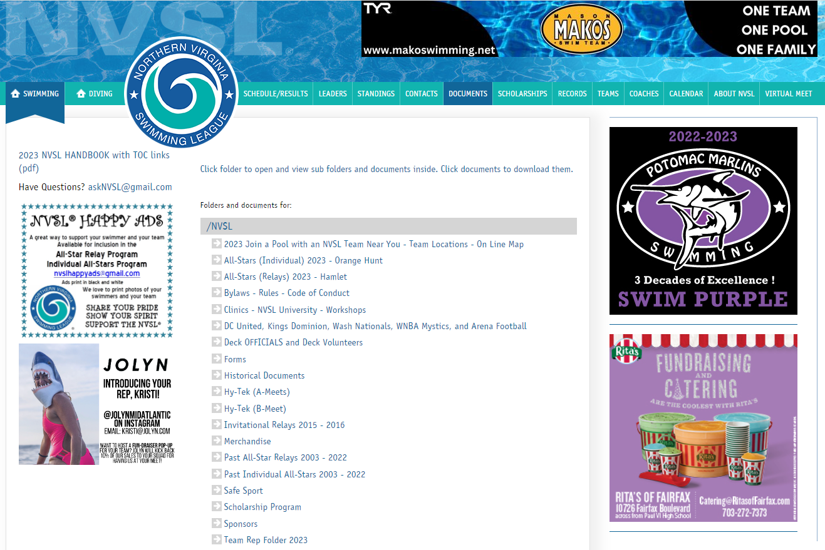
Navigating the NVSL website

Slide 6
Computer Resources
Team Manager and Meet Manager Help files
NVSL Website: http://www.mynvsl.com
  Procedures for A-Meets, Relay Carnival, Divisionals
  Procedures for B-Meets/Time Trials
  Operations Manuals for Meet Manager and Team Manager
  Meet Events and Meet Backup files for A-Meets
  Meet Database templates and Events File templates for B-Meets
  MS Word templates for “fill-in-the-blank” Ribbon Backs and Time Cards
  Meet Program Cover Sheet (MS Word template)
Practice exercises/files in Hy-Tek (A-Meets)/Training/Practical Training Problem
This presentation in Hy-Tek (A-Meets)/Training
Notes:
We encourage everyone to experiment with the software and explore the many features not covered in this training.

Slide 7
Human Resources
Past data person
Opponent’s data person
Division Data Coordinator
Jen Guernsey jenguernsey@gmail.com
NVSL Technology Committee NVSLTechnology@gmail.com
Notes:
We encourage everyone to experiment with the software and explore the many features not covered in this training.

Slide 8
Outline
Introduction
Resources
Software overview
Getting started
Process overview
Tips & tricks

Slide 9
Hy-Tek Applications
One company: Hy-Tek
Two pieces of software:
Team Manager and Meet Manager
Notes:
You need both programs to get you through the summer

Slide 10
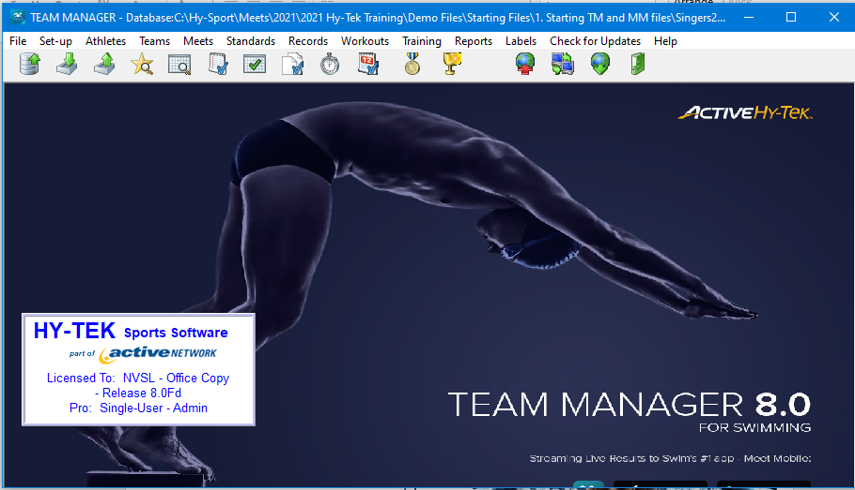
Team Manager 8.0 (TM)
“Filing cabinet”
Store administrative info for swimmers
Team registration (optional)
Maintain team records
Select swimmers for meets
Store meet results
Generate team level reports
Track performance
B meet functions:
  Time cards
  Awards
One database (*.MDB file) per NVSL team
Notes:
You need both programs to get you through the summer

Slide 11
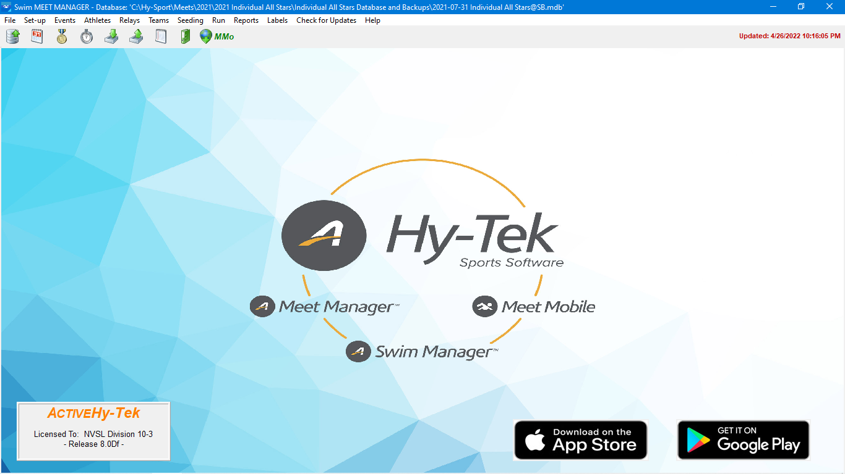
Meet Manager 8.0 (MM)
Merge meet entry files from multiple teams
Seed swimmers into heats and lanes
Print meet programs, time cards
Record times/DQs and score meets
Print meet results and ribbon labels
One database (*.MDB file) per NVSL meet
Notes:
You need both programs to get you through the summer

Slide 12
How TM and MM Work Together
TM
Host Team
Entries
Roster
Records
TM
Away Team
Entries
Roster
Records
MM
Both Teams
Run meet ->
Results
Awards
TM
Host Team
Times
Records
TM
Away Team
Times
Records

Slide 13
High-level Data Flow
BOTH TEAMS
After last meet: Run reports (PB, ladders, etc.)
Mon/Tues: Import TM events (meet “skeleton”)
Wed: Create entries (swimmer selections)
Run reports to check your entries
Export entries
Export roster and records
Your Firm Entry List
HOST TEAM ONLY
Wed: Import MM events (meet “skeleton”)
Thu: Import entries/rosters/records
Thu: Seed meet
Thu: Send out meet sheets
Fri: Print time cards
Sat AM: Run meet
Sat PM: Generate meet reports
Sat PM: Export results, send to DDC
BOTH TEAMS
Sat/Sun: Import results
Sat/Sun: Generate meet/team reports

Slide 14
Outline
Introduction
Resources
Software overview
Getting started
Process overview
Tips & tricks

Slide 15
Getting the Software
Need both TM 8.0 and MM 8.0 on PC laptop
Contact Michelle Hale at NVSLTechnology@gmail.com if you need to install TM &/or MM on a new laptop
Installation instructions on website in Documents at Hy-Tek (A-Meets)/Procedures/Tips

Slide 16
Software Quirks
You can run the Olympics!
(Nearly) All changes saved automatically
Zip files/1001 clicks to open a file
Collated printing doesn’t work; save as PDF, then print
B meet time card printing glitch

Slide 17
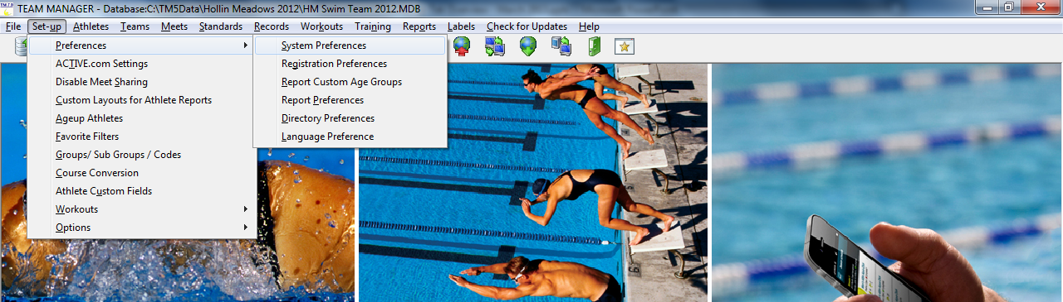
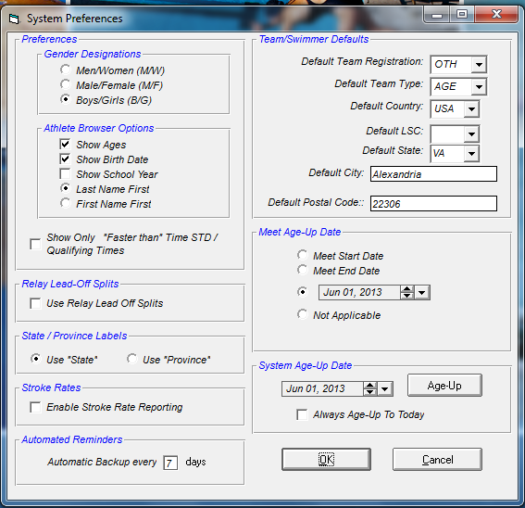
TM System Age-Up Date
Meet and System Age-Up settings controls how the software determines a swimmers age for reports and various information screens
For the NVSL a swimmer’s competition age is determined by his/her age on June 1st
  Meet Age-up Date is used by default if not specified in meet events file
  It is recommended that the System Age-Up setting be set to June 1st
  You can always change the setting if a swimmer’s true age is required
Meet Age-Up Date
System Age-Up Date

Slide 18
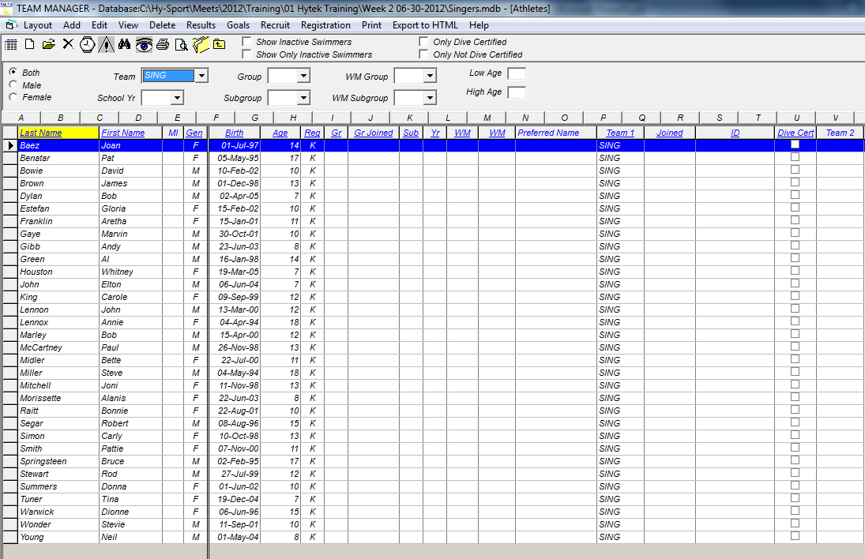
Add/Modify Athletes in TM
Click Athletes from the TM main menu
Add new Athletes
Notes:
Good example of a Hy-Tek grid screen
Icons roughly match main menu items
Some menu items apply to currently highlighted entry
Inactive lets you logically delete a swimmer
Show Inactive.. Is clear when you come to this screen
I usually “delete” all my swimmers at the beginning of each season then reactivate them as their forms come in

Slide 19
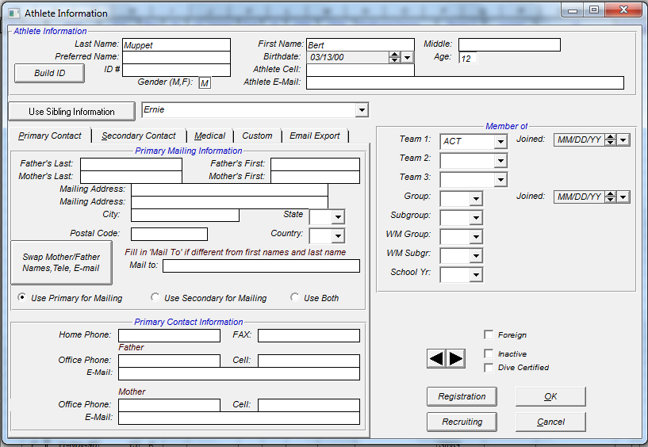
Add/Modify Athletes in TM
Absolutely Critical
Shows up when second athlete with same last name is entered
Tabs
Logical deletion, but remains in system
Be sure to enter birthdates for all swimmers
Can make all your swimmers inactive and then activate them as they register for the new season
Notes:
Double-click a swimmer to modify an existing swimmer
Click Add to create new swimmer
Required fields are First Name, Last Name, Gender, Team, and Birthday
Double-check Gender and Birthday
Inactive checkbox allows logical deletion of swimmers
Show Inactive Swimmers checkbox controls visibility of inactive swimmers
One strategy is to make all your swimmers inactive and then activate them as they register for the new season
Use Sibling Information button makes entering duplicate family information easy, but beware:
It only copies the first tab of information
If you subsequently change the original, the change will not cascade to the copy, and vice versa

Slide 20
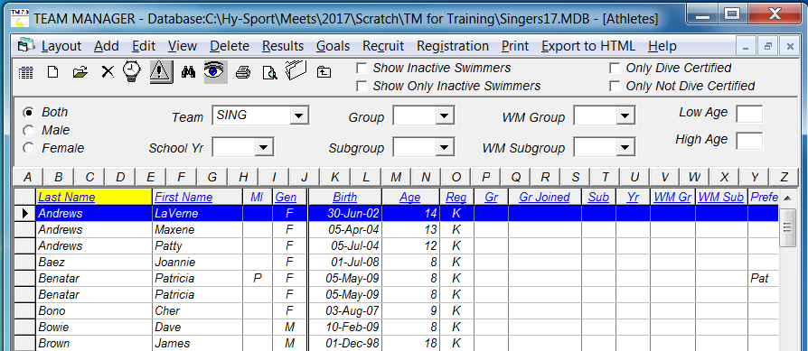
TM Duplicate Swimmer Names
Check your TM database for duplicate swimmers
  Most common issue is one with a middle initial and one without
Drag swimmer to drop onto the other (the one to keep) or edit the athlete information of the one to drop

Slide 21
TM No Swimmer Athletes
No Swimmers = Dummy swimmers to fill in empty lanes
Need enough No Swimmers in your TM database to fill in all empty lanes with the same restrictions as real swimmers (age, gender, maximum entries)
Samples:
  Swimmer, No1 (No2, No3)
  NoSwimmer, Boy1 (Boy2, Boy3)

Slide 22
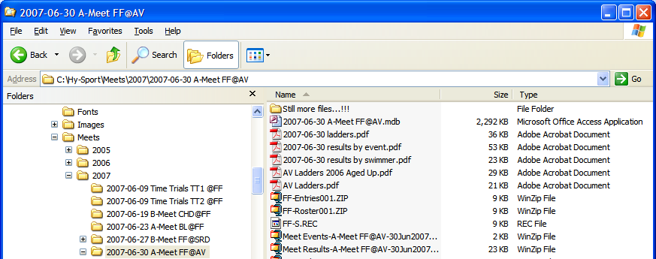
File Structure and Directories
Organize your meet files by directories
  Create a separate subdirectory for each meet
  Put every file associated with a meet in its subdirectory
  C:\Hy-Sport\Meets\2024\meet name
    Example meet name: 2018-06-23 A-Meet DH@DT
Notes:
I’m now in Windows Explorer

Slide 23
Naming Conventions
Course naming conventions
  25 yard pool = SCY = Yards = Y
  25 meter pool = SCM = Short Course = S
  50 meter pool = LCM = Long Course = L
  Y’, S’, etc. means converted time, used inconsistently
NVSL meet name (internal meet name)
  NVSL A-Meet HV@FMW
NVSL meet database (filename)
  2019-06-22 NVSL A-Meet HV@FMW.mdb
NVSL meet events file (filename)
  Meet Events-NVSL A-Meet HV@FMW-22Jun2019-001.zip
Record files (files containing team or league records, *.rec file name)
  Use team abbreviation for internal name, e.g., PT or DL
  External *.REC exported name will automatically become PT-S.REC or DL-Y.REC where “-S” indicates short course (meters) and “-Y” indicates yards
Typical High School and College pools
Most common in NVSL
Olympic size pools

Slide 24
Definitions
A meet consists of a collection of events (e.g. Boys 8&Under 25 Meter Freestyle) which may be grouped into sessions
A session is a group of events, not typically used by NVSL
  Typical example from Potomac Valley Swimming:
  Morning session: 13 & Over Prelims
  Afternoon session: 12 & Under Timed Finals
  Evening session: 13 & Over Finals
  Division Individual Championship has multiple sessions
An event is swum with one or more heats
  Division Individual Championship (Divisionals), All Star Relays, and Individual All Stars have multiple heats
Hierarchy is Meet/Session/Event/Heat

Slide 25
Outline
Introduction
Resources
Software overview
Getting started
Process overview
Tips & tricks

Slide 26
Team Manager
Both Teams – Pre-Meet Activities
Set up time/method for data exchange
Download and import meet events (“skeleton”)
Select swimmers
Export entries, roster and records
Notes:
Time to

Slide 27
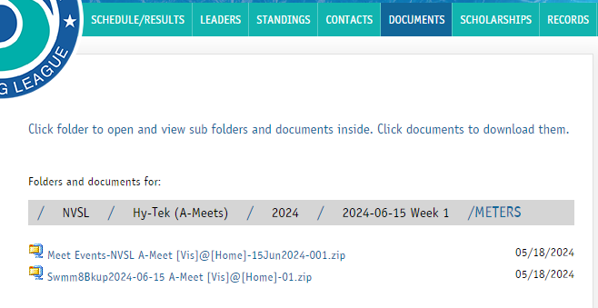
Downloading Meet Events
Download generic meet events file from NVSL Website – www.mynvsl.com
Documents tab
Hy-Tek / 2024 / 2024-06-15 Week 1 / METERS or YARDS folder
2 files: Meet Events for TM and Meet Backup for MM
Save files to the folder setup for the meet
(C: > Hy-Sport > Meets > [Year] > [Meet])
Visiting Team only needs the Meet Events file
Host Team needs both the Meet Events and Meet Backup file
Notes:
File | Import | Meet Events
Meet events files are created by the NVSL for A-Meets and posted to the NVSL website. Each team should download the events file from the website.
[B-Meets] Someone (possibly you) will have provided you with an Events file template for B-Meets
Generally the templates are also posted to the NVSL website
Select the appropriate Events file or Events file template
After clicking OK, the new meet will appear on the Meets screen (scroll to the top if you don’t see it!)
Open the meet (double click on the name), verify the information (teams, course, date, etc.), and change Meet Type to “A”

Slide 28
Import Meet Events into TM
File | Import | Meet Events
  Meet events files are created by the NVSL for A-Meets and posted to the NVSL website. Each team should download the events file from the website.
  [B-Meets] Someone (possibly you) will have provided you with an Events file template for B-Meets
    Generally the templates are also posted to the NVSL website
  Select the appropriate Events file or Events file template
  After clicking OK, the new meet will appear on the Meets screen (scroll to the top if you don’t see it!)
  Open the meet (double click on the name), verify the information (teams, course, date, etc.), and (optional) change Meet Type to “A”

Slide 29
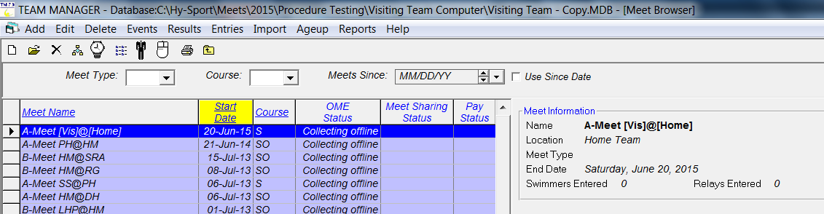
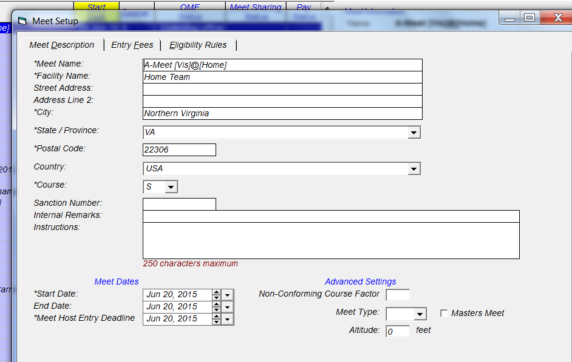
Importing Meet Events
From Main Menu select File | Import | Meet Events – follow on screen directions
From Main Menu select Meets and this screen will come up
Edit Meet Description
(Optional) Set Meet Type to “A”
Notes:
File | Import | Meet Events
Meet events files are created by the NVSL for A-Meets and posted to the NVSL website. Each team should download the events file from the website.
[B-Meets] Someone (possibly you) will have provided you with an Events file template for B-Meets
Generally the templates are also posted to the NVSL website
Select the appropriate Events file or Events file template
After clicking OK, the new meet will appear on the Meets screen (scroll to the top if you don’t see it!)
Open the meet (double click on the name), verify the information (teams, course, date, etc.), and change Meet Type to “A”

Slide 30
Entering Athletes in Meet
On the Meets screen, highlight the meet for which you wish to create entries
Entries | Swimmer Entry Status (Optional)
  Pre-enter all swimmers, then clear anyone on your unavailable list for that meet
Entries | Entry by Event
  Set the Only Pre-Entered Athletes checkbox to mask unavailable swimmers
  Swimmers will show up by their age on the day of the meet
  Proceed through the events, one-by-one, entering swimmers
  You can supply custom times to control lane assignments
  A warning message will appear if you exceed an entry limit. The entry which caused the warning will be created, requiring a correction on your part.

Slide 31
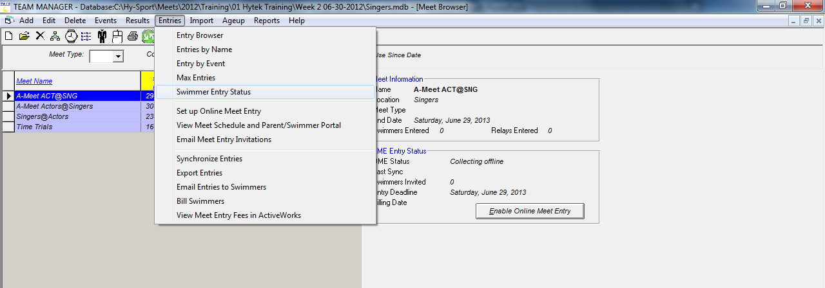
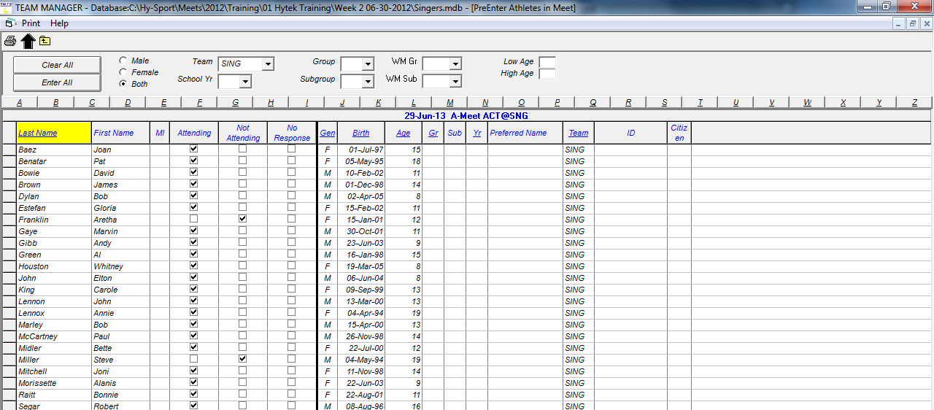
Pre-Entering Athletes in a Meet
First pre-enter all athletes
Second, uncheck the athletes that will not be at the meet
Notes:
Most people do this for A-meets, not for B-meets

Slide 32
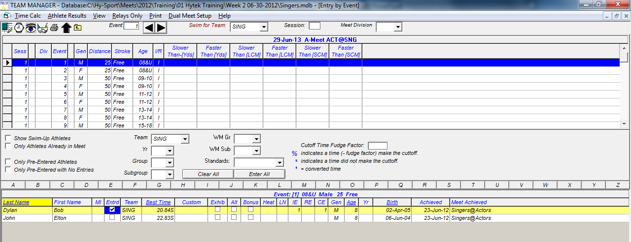
Entries by Event, Individual Events
Next Event
Click check box to select entries
Track entries
IE – individual entries
RE – relay entries
CE – cumulative entries
Age as of 1 June
Enter Custom Times to control lane assignment
Grid View Basics
Click on underlined column heading to sort by that column
Click on letter to show swimmers with last name beginning with letter
Notes:
On the Meets screen, highlight the meet for which you wish to create entries
Entries | Swimmer Entry Status
Pre-enter all swimmers, then clear anyone on your unavailable list for that meet
Entries | Entry by Event
Set the Only Pre-Entered Athletes checkbox to mask unavailable swimmers
Swimmers will show up by their age on the day of the meet
Proceed through the events, one-by-one, entering swimmers
You can supply custom times to control lane assignments
A warning message will appear if you exceed an entry limit. The entry which caused the warning will be created, requiring a correction on your part.

Slide 33
Entering Athletes in Meet, cont.
To enter swimmers in a relay…
  Set/clear the checkboxes at the left side of the screen as appropriate
  Select your team from the Swim for Team and Team combo boxes
  Create a relay by clicking New Relay
  Add swimmers to your relay by double-clicking or dragging them
  Remove swimmers by double-clicking them
  Swap the legs of two swimmers by dragging one on top of the other
  Find Best Relay only works for 8&Under and 15-18 age groups

Slide 34
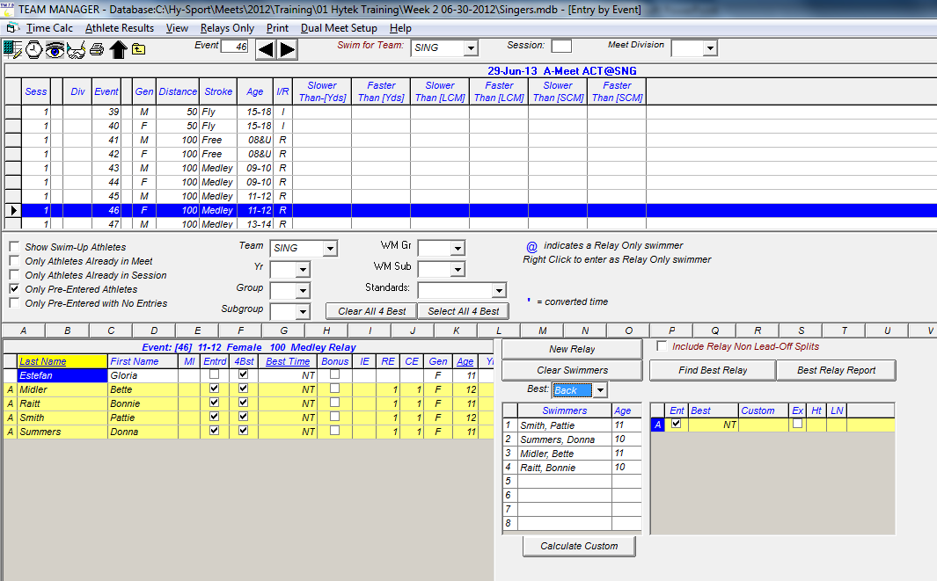
Entries by Event, Relay Events
First, click New Relay
Next, double click or drag swimmers to fill relay
Select stroke to see times for that stroke
Double click to remove swimmer from relay
Notes:
Find Best Relay will only help you for 8&Under Free and 15-18 Medley
This is because it looks for matching distances !!!
To enter swimmers in a relay…
Set/clear the checkboxes at the left side of the screen as appropriate
Select your team from the Swim for Team and Team combo boxes
Create a relay by clicking New Relay
Add swimmers to your relay by double-clicking or dragging them
Remove swimmers by double-clicking them
Swap the legs of two swimmers by dragging one on top of the other
Find Best Relay only works for 8&Under and 15-18 age groups

Slide 35
A-Meet Entry Reports
After entries are completed, you should run some reports from the Reports | Meet Reports | Meet Entries dialog
  Individual and Relays sorted by Meet Event Number
  Individual and Relays sorted by Name

Slide 36
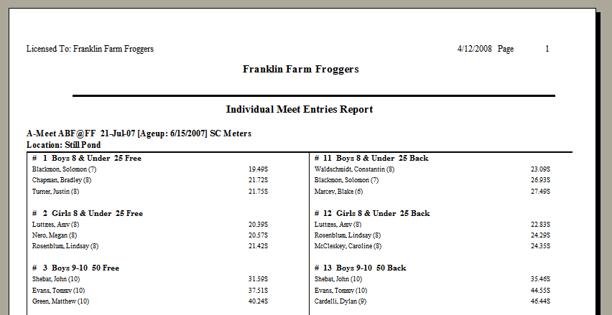
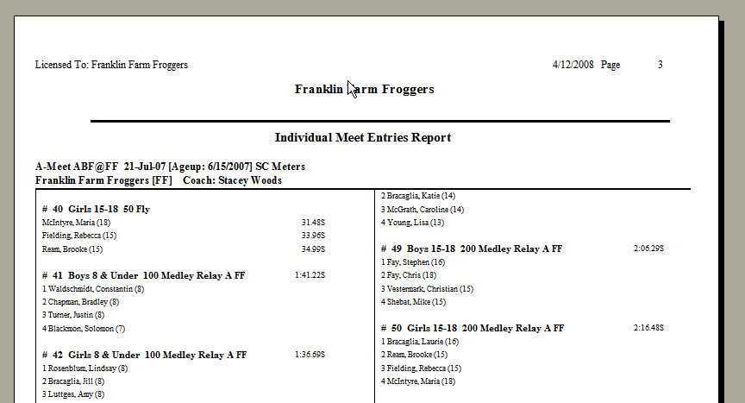
Entries by Event
Looking for
No more than 3 swimmers per individual event
“No swimmer” entry if fewer than 3
Swimmers of proper ages
4 swimmers for relays
Proper ages for mixed age relay
Right swimmers in the right events
Notes:
After entries are completed, you should run some reports from the Reports | Meet Reports | Meet Entries dialog
Individual and Relays sorted by Meet Event Number
Individual and Relays sorted by Name

Slide 37
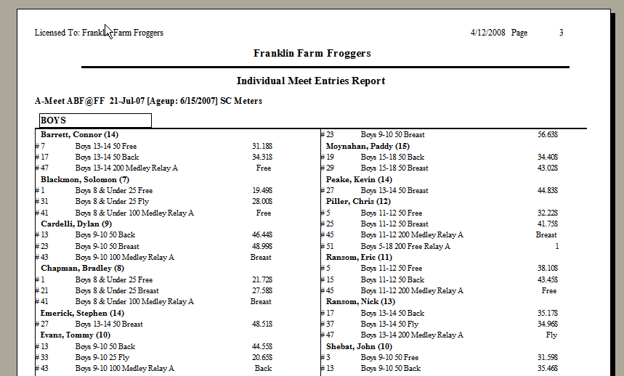
Entries by Name
Looking for
No more than 2 Individual events and no more than 2 Relay events (Age group and mixed age)

Slide 38

Create entries
HOT TIPS
Work with team rep for clear/accurate meet declaration process…your sanity depends on it!
Double-check your entries…it’s easy to hit the wrong checkbox
Enter “No Swimmers” so you have full lanes in all events
Watch for “too many entries” flags
Run reports to check max events per swimmer/max swimmers per event
Run reports by event (for coach review) and by swimmer (for parent review). Can toggle to include/omit times
Be sure to include relays when exporting…check the box!
Allow time for corrections before data exchange

Slide 39
Export
Entries
Roster
Records
PDF of entries → This is your FIRM ENTRY LIST
Both teams send 4 files to each other as agreed

Slide 40
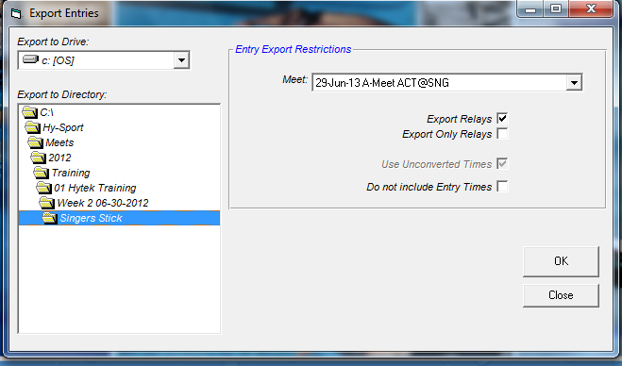
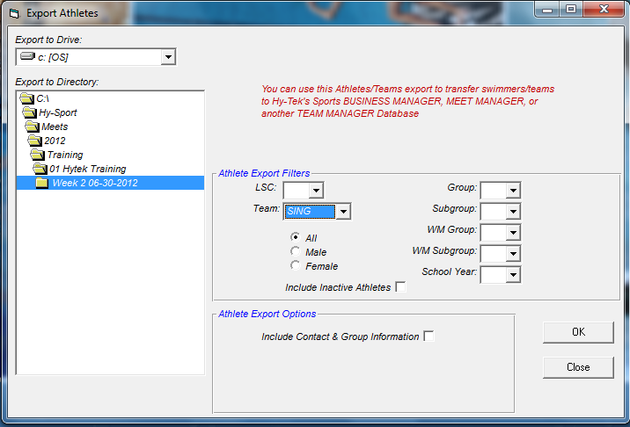
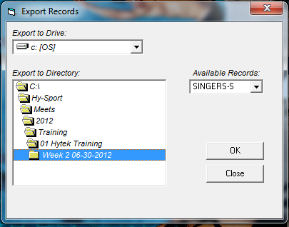
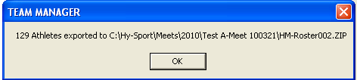
Export Files
Export Meet Entries
  File | Export | Meet Entries
Export Roster
  File | Export | Athletes/Teams
Export Records
  Records | Export Records
    For a given “record set”, this function creates a .REC file which can be imported into a MM meet database
Directory set up for meet
If also keeping Yard records, make sure to look for the “-S” for Short Course Meters or “-Y” for Yards
Notes:
Entries are done, time to export…
Make sure it’s the correct meet
Make sure you export to the correct directory

Slide 41
Export Team Roster from TM
File | Export | Athletes/Teams

Slide 42
Export Team Records from TM
Records | Export Records
  For a given “record set”, this function creates a .REC file which can be imported into a MM meet database
If also keeping Yard records, make sure to look for the “-S” for Short Course Meters or “-Y” for Yards

Slide 43
Meet Manager
Host Team – Pre-Meet Activities
(A-Meets)
Draft meet cover sheet
Download and prepare meet database
Import entries, rosters and records
Assign teams to proper lanes
Seed swimmers into heats
Print meet program
Print time cards

Slide 44
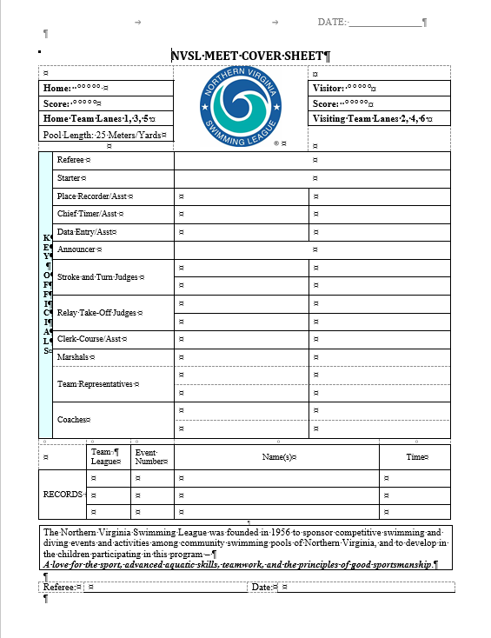
Meet Cover Sheet
Available from website Documents folder under Hy-Tek (A-Meets)/Procedures/A Meets or under Forms
Names of officials
Score + ref signature at end of meet
Draft before meet (get names of officials from team reps)
Finalize/print at meet
ONE PAGE – reformat as needed

Slide 45
Prepare Meet Database
Download the Meet Backup file from the NVSL website
  Save to the directory set up for the meet
Open Meet Manager and from the main menu select
  File | Restore to restore the database
    Select “Unzip, copy database to a selected folder, and open this new database” option
  Set-up | Meet Set-up to edit the meet information
    Meet name and location information
    Verify meet and age up dates
  File | Save As and edit the file name with visiting and host team initials to properly identify meet
    Delete the generic version once the specific one is created

Slide 46
MM Import Entries and Rosters
File | Import | Entries
  Import the entries for both teams (any order)
  Run Reports | Exceptions Report
    Highlight Session 1
    Click Exceed Maximum Entries per Athlete, set limits to 4/2/2
      Create Report
    Click Exceed Maximum Entries per Team per Event, set limit to 3
      Create Report
  No data is good, means there are no problems
File | Import | Rosters Only
  Import the rosters for both teams that are in the meet

Slide 47
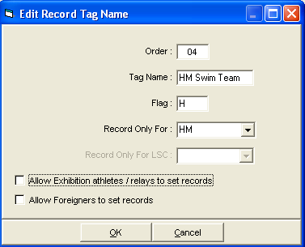
Import Records into MM, cont.
This step should wait until after Entries and Rosters have been imported
Meet database will have NVSL records and All Star time standards included
Select each team’s “record set”, and use the edit dialog to
  Identifying flags
  Teams to which records apply

Slide 48
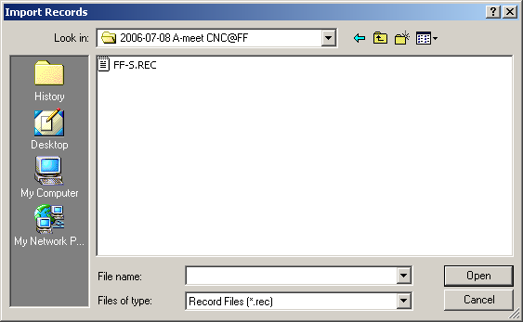
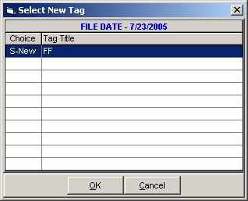
Import Records into MM
File | Import | Records | Import
  Import records for both teams
Select each team’s “record set”, and use the edit dialog to set
Identifying flag used on reports, and
Team to which records apply

Slide 49
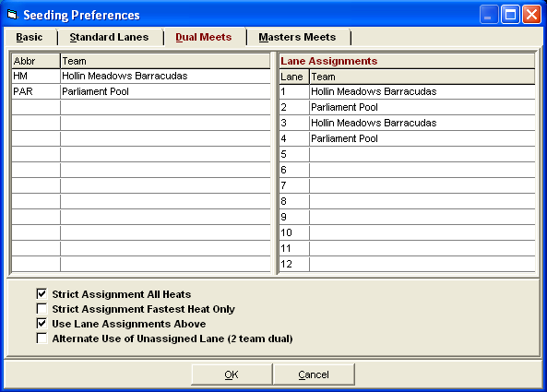
Assign Teams to Lanes in MM
Set-up | Seeding Preferences => Dual Meets
  Host team in lanes 1, 3 and 5
  Double click or drag team name to appropriate lane

Slide 50
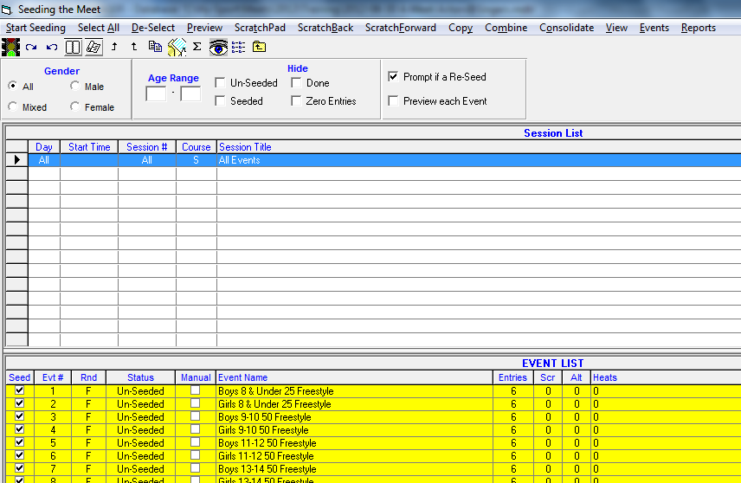
Seed A-Meet Events in MM
2
1

Slide 51
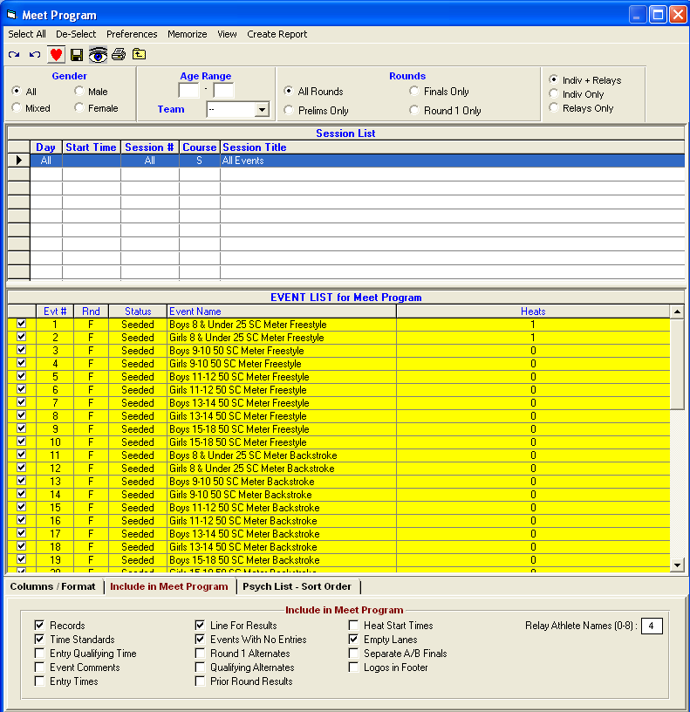
Print the Meet Program
Reports | Memorized Reports => 2 Column meet sheet for distribution => Run Report
  Highlight All in the session list, select all of the seeded events, then click Create Report
  Review with other team, make corrections if necessary
  Print plenty of copies (Referee, Starter, Stroke & Turn Judges, Announcer, Clerks of Course, Coaches, Head Timer, etc.)
Notes:
Note two tabs at the bottom…
The control the format of the program and what is included in the program…

Slide 52
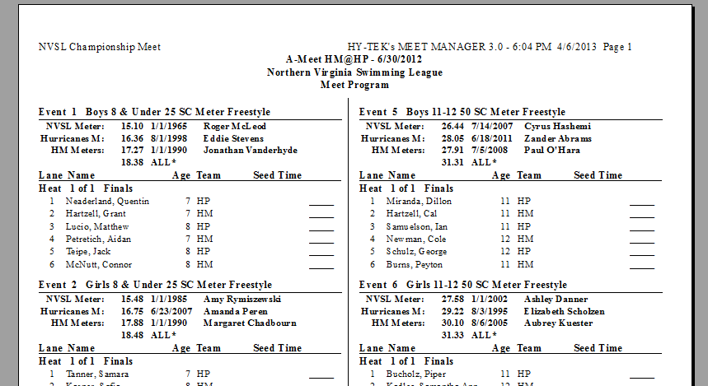
A-Meet Program
Records and previous year All Star qualifying time
Host team in lanes 1, 3 and 5
No seed times
Fastest swimmers in middle lanes or where desired
Only 1 heat of 6 swimmers
Record Flags and Standards
  All-star cuts and NVSL records are included in the meet database provided by the NVSL
    ‘!’ is reserved for NVSL records
    All* is used for projected All-star cuts (qualifying times)

Slide 53
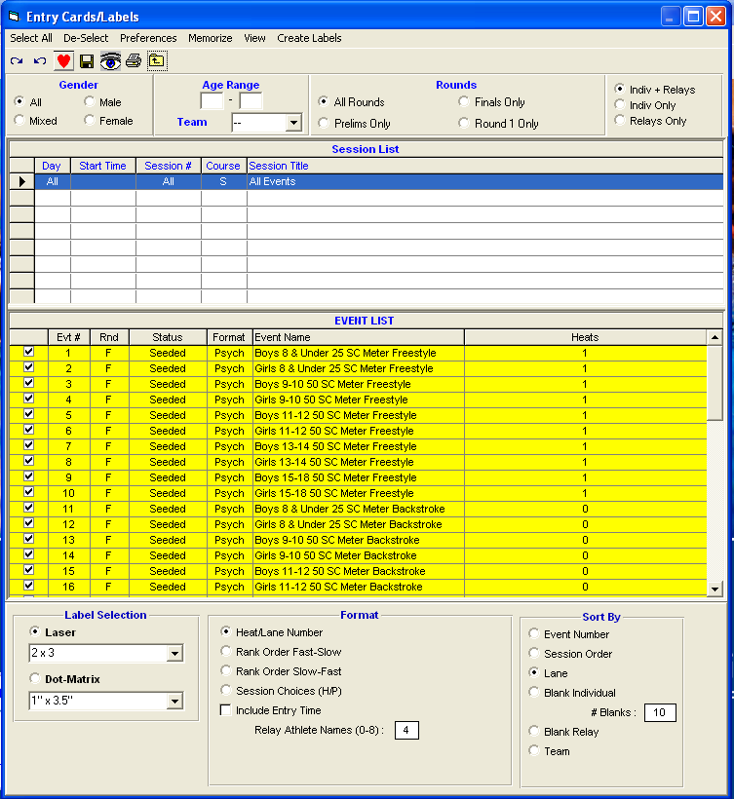
Print A-Meet Time Cards
Reports | Memorized Reports => Cards sorted by lane => Run Report
  Select All in the list of sessions
  Select the events for which you need time cards – generally Select All
  Create Labels
  Be sure to maintain event/lane order

Slide 54
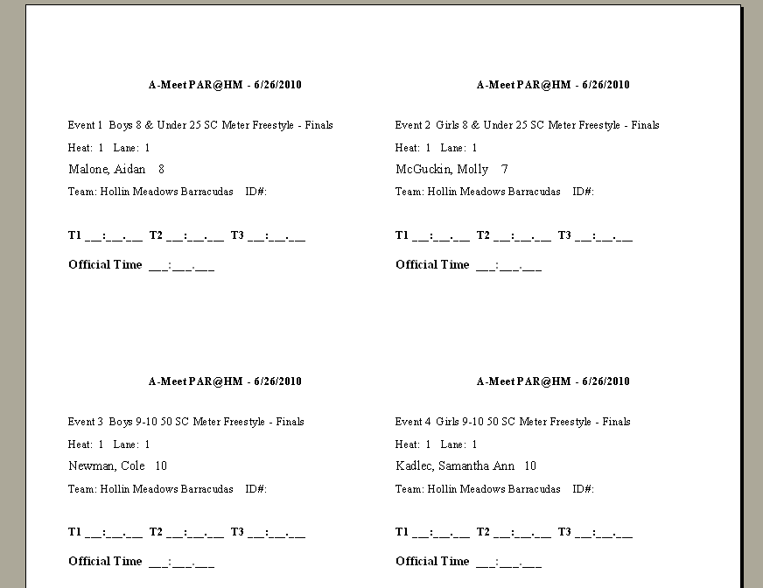
A-Meet Time Cards

Slide 55
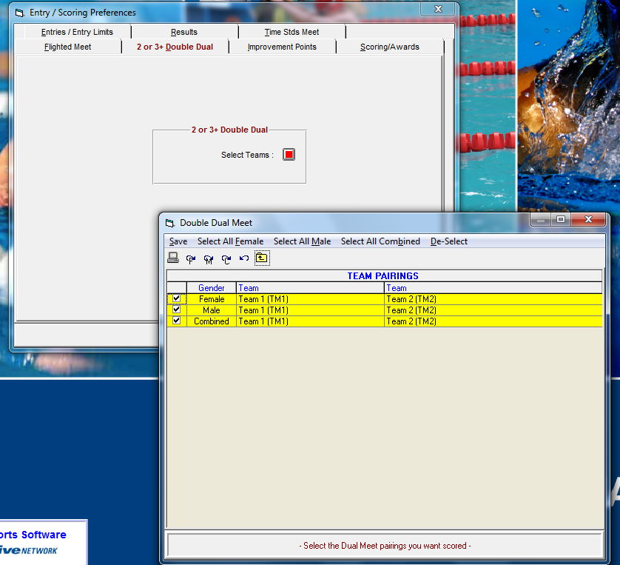
Verify Scoring Preferences
Set-up | Entry / Scoring Preferences => 2 or 3+ Double Dual => Select Teams
  Verify Female, Male and Combined are checked and both teams are listed
  If you don’t do this on Thursday, MM will generate a warning once the results of the first event are “Scored” on Saturday morning

Slide 56
Running the Meet
Make pre-meet scratches and substitutions
Enter results for each event
Print event results for verifier and announcer
Print award labels for ribbons
Print final meet results
Cover sheet/ref signature
Backup database, send to DDC
Export meet results for Team Manager
Notes:
Time to

Slide 57




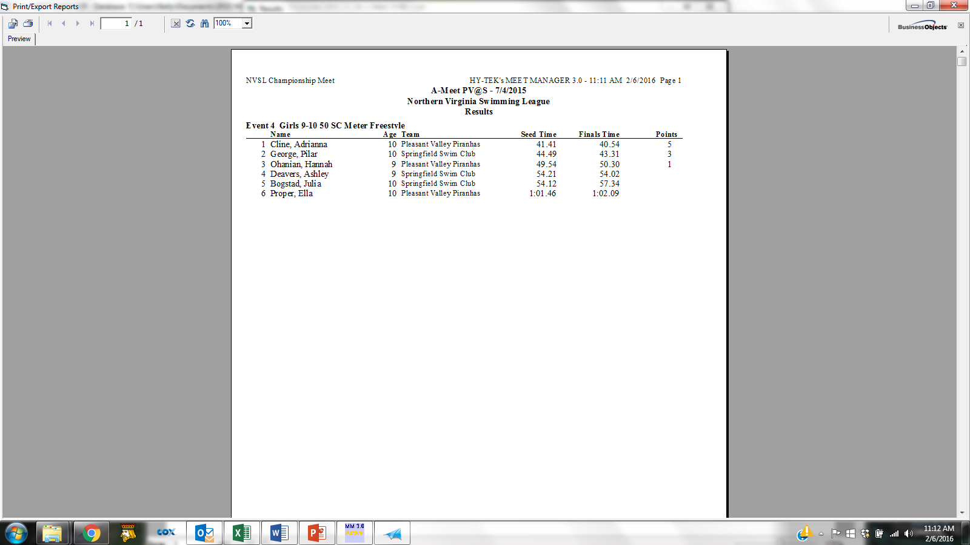

Time Card and Data Flow at Meet
Stopwatches
A-Meet PV@S-7/4/2015
Event 12 Girls 8&Under 25 SC Backstrioke – Finals
Heat: 1 Lane: 2
Palmer, Morgan 6
Team: Pleasant Valley Piranhas
T1:__:__.__ T2__:__.__ T3__:__.__
Offiical Time__:__.__
A-Meet PV@S-7/4/2015
Event 12 Girls 8&Under 25 SC Backstrioke – Finals
Heat: 1 Lane: 2
Palmer, Morgan 6
Team: Pleasant Valley Piranhas
T1:__:__.__ T2__:__.__ T3__:__.__
Offiical Time__:__.__
2
DQ Slips
Time Cards
Timers
Chief Timer
Runner (optional)
Place Recorders
3
A-Meet PV@S-7/4/2015
Event 12 Girls 8&Under 25 SC Backstrioke – Finals
Heat: 1 Lane: 2
Palmer, Morgan 6
Team: Pleasant Valley Piranhas
T1:__:__.__ T2__:__.__ T3__:__.__
Offiical Time__:__.__
Scratches and Substitutions
1
Time Cards
4
Printed Results
6
Data Entry
Verifiers
5
7
Award Labels
Meet Mobile
Official Results
Award Clerks
Announcer
Cloud

Slide 58
How Times and Scores are Recorded
Three stopwatches; middle time used
  Timers verify their time on the timecard before clearing watch
  Head Lane Timer writes down middle time on card
Chief Timer quickly checks timecards before passing to Place Recorders
Place Recorders verify correct official time, attach DQ slips, check for records and write down place on cards
Data Entry enters watch times into HY-TEK and calls back times and places to Time Caller
  Prints out event results for verifier
Verifiers check results against timecards. When confirmed correct:
  Passes printed event results to Announcer
  Notifies Data Entry
    Upload event results to Meet Mobile
    Print out award labels for ribbons (after each stroke block is complete)
At end of meet, Data Entry prints out official results
Referee reviews results, noting correct DQs, and signs results

Slide 59
Run an A-Meet
Enter times; do not enter times for disqualified swimmers
  No punctuation or mental arithmetic is required – 12345 will be translated to 1:23.45
  Enter NS (no swim), DFS (declared false start), or DNF (did not finish) as appropriate
Check DQ (disqualification) box if appropriate
Event status will change values as you enter times and score events – Seeded, Done, Scored
Record-breakers will be highlighted in the Records sub-window
After an event is Done, you need to explicitly Score the event. Scores will appear in the Scores sub-window.
When an event is scored, a results window comes up => print, pass to “Verifier” to check against time cards
If you correct a time in a scored event, then you need to explicitly Re-Score the event

Slide 60
Run an A-Meet in MM, cont.
Run, continued
  Use Adjust : F8 to change swimmers. If the swimmer is not in the meet, you will need to create the swimmer via Athletes. If you make up a birthday or use a nickname, you will have to reconcile this later in TM.
  In the Adjust : F8 window, double-click a swimmer to remove her from a heat. Then set the Show Eligible Athletes radio button. Finally, drag the replacement swimmer to the lane that was emptied.
  Use Rel Names : Ctrl-R to adjust relay swimmers. Double-click a swimmer to remove her from a relay. Drag an eligible athlete onto a relay to make her part of the relay. Drag one relay swimmer onto another to swap relay legs for the two swimmers.

Slide 61
Run an A-Meet in MM, cont.
Run, continued
  DO NOT re-seed an event after changing swimmers, unless you want to re-print time cards and meet programs
  If you replace a swimmer for a scored event, you will have to re-enter her time and re-score the event

Slide 62
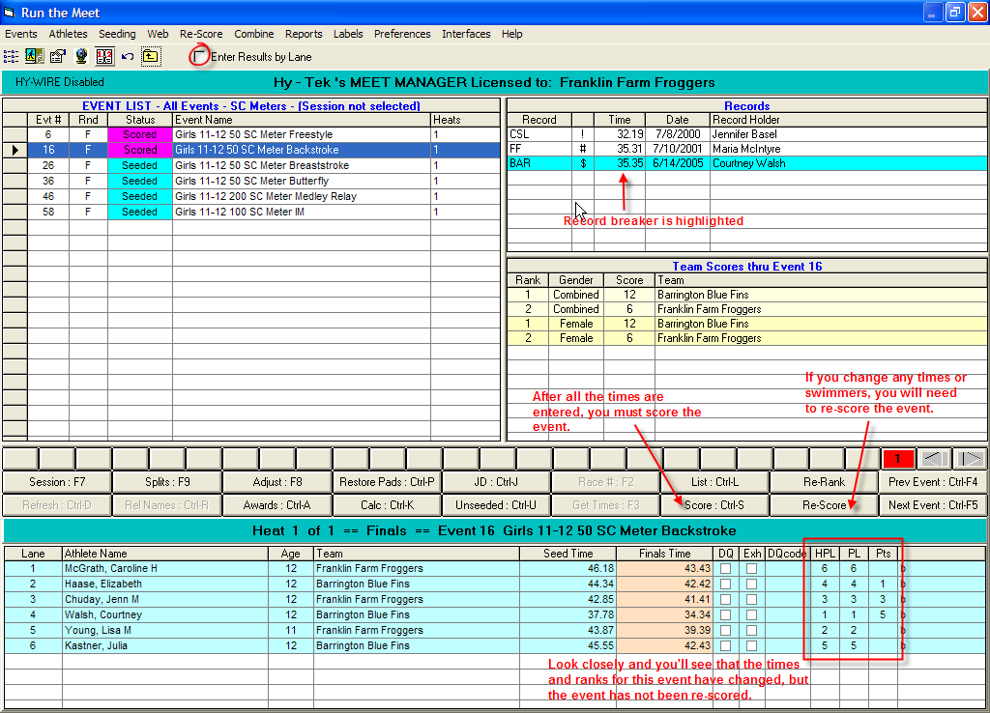
Run Screen
Notes:
If you see workers at a laptop on a table at a high school or PVS meet, this is the screen they are usually on…
Run
Enter times, do not enter times for disqualified swimmers
No punctuation or mental arithmetic is required – 12345 will be translated to 1:23.45
Enter NS for competitors who do not swim
Enter DQ, DFS, or DNF as appropriate
Event status will change values as you enter times and score events – Seeded, Done, Scored
Record-breakers will be highlighted in the Records sub-window
After an event is Done, you need to explicitly Score the event. Scores will appear in the Scores sub-window.
When an event is scored, a results window comes up => print, pass to “Verifier” to check against time cards
If you correct a time in a scored event, then you need to explicitly Re-Score the event.
Use Adjust : F8 to change swimmers. If the swimmer is not in the meet, you will need to create the swimmer via Athletes. If you make up a birthday or use a nickname, you will have to reconcile this later in TM.
In the Adjust : F8 window, double-click a swimmer to remove her from a heat. Then set the Show Eligible Athletes radio button. Finally, drag the replacement swimmer to the lane that was emptied.
Use Rel Names : Ctrl-R to adjust relay swimmers. Double-click a swimmer to remove her from a relay. Drag an eligible athlete onto a relay to make her part of the relay. Drag one relay swimmer onto another to swap relay legs for the two swimmers.
DO NOT re-seed an event after changing swimmers, unless you want to re-print time cards and meet programs
If you replace a swimmer for a scored event, you will have to re-enter her time and re-score the event

Slide 63
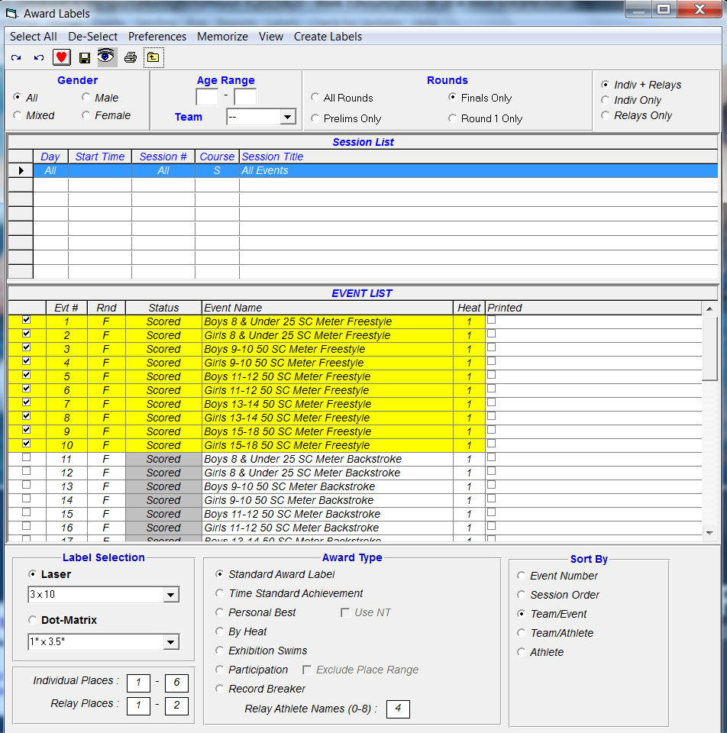
Print Award Labels
After every stroke block and results have been verified
Reports | Memorized Reports => Award Labels All Places => Run Report
  Note that labels for each team can be printed separately
Print labels for all individual and relay places

Slide 64
MM Meet Mobile
Meet Manager 8 supports a smartphone application called Meet Mobile.
  Users subscribe annually or monthly
  Psych sheets, heat sheets, rosters, records and time standards can be available before the meet and results by event and swimmer, places and scores during meet (data entry computer must be connected to internet to enable near real-time results during the meet)
  To charge for meet data team needs an Active.com account
League policy
  Publish psych sheets, meet programs, etc. at team discretion including charging a fee (may want to coordinate with Division)
  Manually publish results only after verified at the table and if not under protest. Publish scores at the end of the meet.
Meet Mobile operation (see User Guide and A-Meet Procedures)
  Set-up | Meet Mobile Publishing to publish pre-meet information
  Run | Meet Mobile to publish near real-time results
    Uncheck Activate the Meet Mobile System
    Ctrl-M from Run screen to publish results, Ctrl-O to publish scores

Slide 65
Run an A meet
HOT TIPS
Cards should come to you in lane order
To read or not to read cards? Personal preference
Check place order on computer against cards
Set up Preferences>Results for List and Score so you include league/team records and scores (for the announcer)
Do not print labels until results have been verified
Be sure to check printer contents (paper vs labels) before you print
Double-check label size before printing
Keep scratch forms, attach to results (take photo, provide to other teams as agreed)

Slide 66
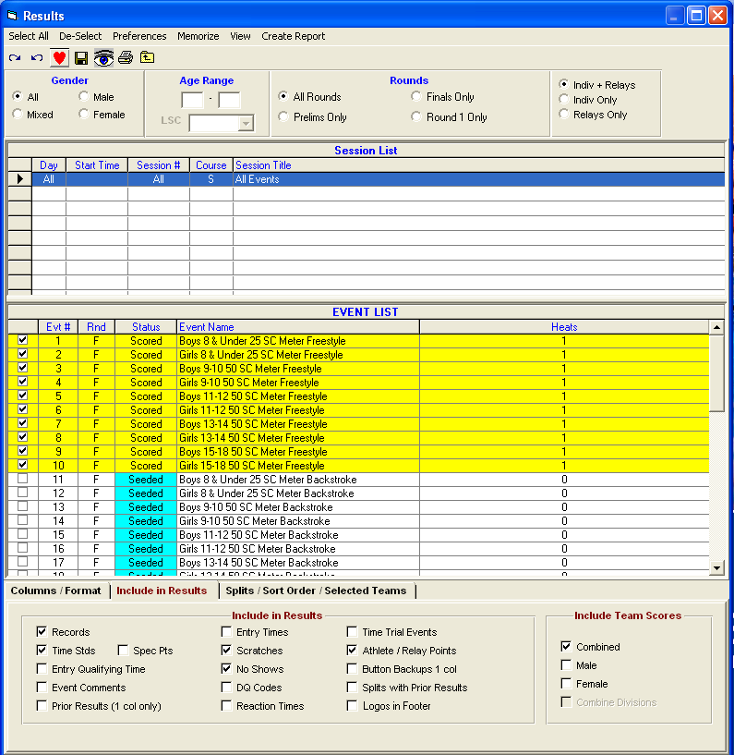
A-Meet Output
Can print intermediate results if desired
Reports | Memorized Reports => Finals Results Report => Run Report
  Select All in the list of sessions
  Select the events for which you need results
  Create Report

Slide 67
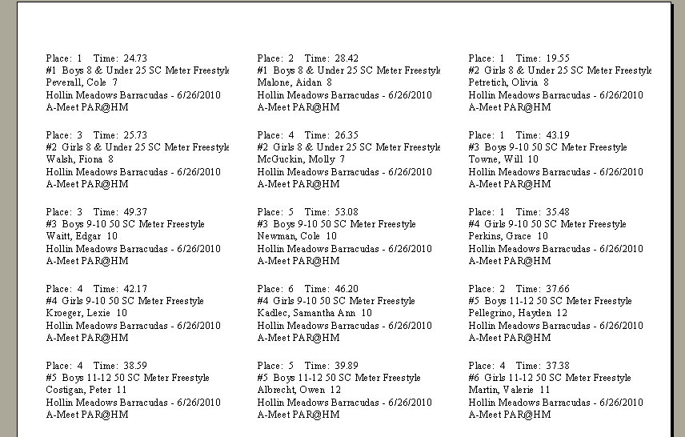
Award Labels

Slide 68
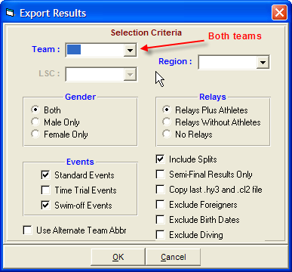
Print Meet Results and Export
Print final meet results and attach cover sheet to be signed by referee => Official results
  Can print other reports to help referee such as Reports | Meet Summary and select DQ Summary or 1st Round Scratches
File | Backup
  Creates a ZIP file containing the meet MDB file
  Copy to visiting team
  Copy to Division Data Coordinator via email
  Please SEND THE BACKUP, NOT THE RESULTS
  Do not Lock the meet backup
File | Export | Meet Results for
Team Manager or SWIMS or
NCAA Database
  Copies to both teams

Slide 69
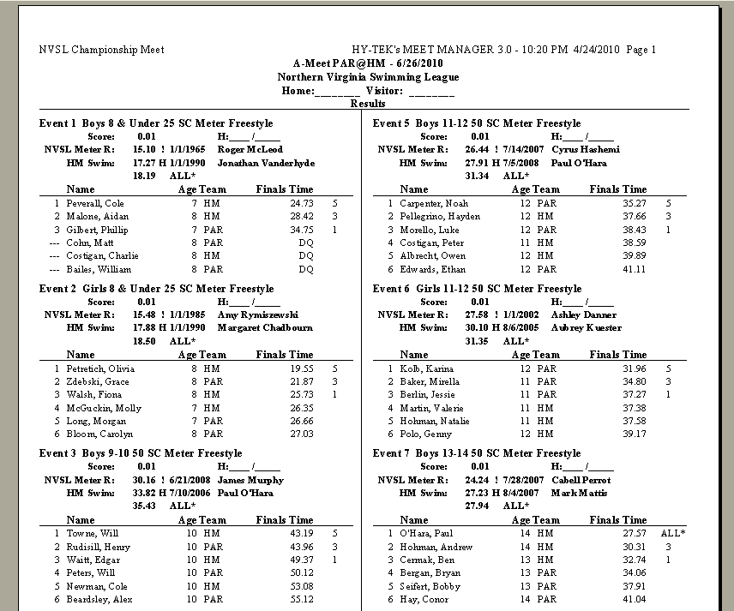
Results by Event

Slide 70
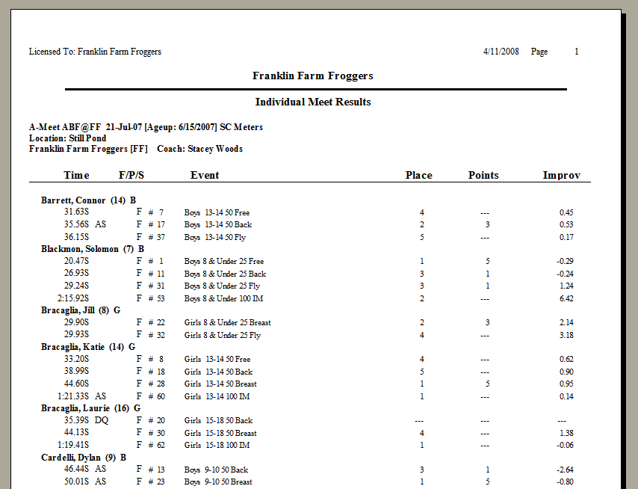
Results by Swimmer

Slide 71
Team Manager
Post-Meet Activities
Import Results
Generate Reports

Slide 72
Import Meet Results into TM
After the meet is over, File | Import | Meet Results
  Athletes and times from either or both teams can be brought into your team database
  DDC will also provide files from other teams in your division

Slide 73
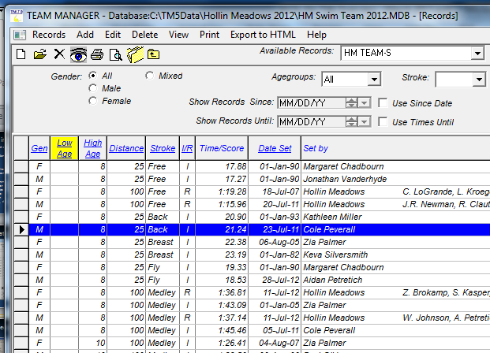
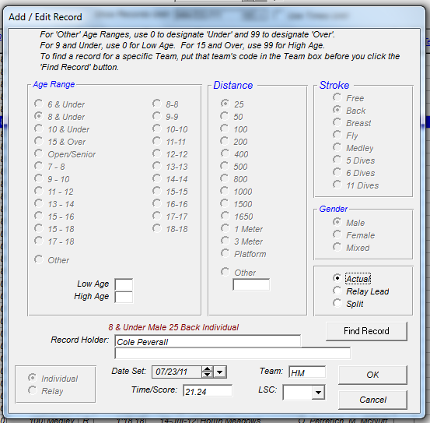
TM Update Team Records
Edit Record
Notes about records
Mixed Age 200 Freestyle Relay is seen by software same as 15-18 200 Freestyle Relay (Relay Carnival) so best not to let software automatically update records after Relay Carnival or at all
If your team tracks 8&Under IM records you also need to make a 10&Under IM record for Divisionals – event name has to match
8&Under Medley Relay is now a true medley relay not a modified relay, to preserve modified medley relay record need to create a new event such as 200 Medley Relay

Slide 74
Generate Reports in TM
Reports | Meet Results
  Display by event or by swimmer
  Time improvement shown is against best time in system unless you specify otherwise
Reports | Performance
  Check for and update team records via Record Match
    Be careful after Relay Carnival as the 15-18 200 Free Relay will update the Mixed Age 200 Free Relay record
    Preview record breakers prior to checking Update Records checkbox
  Generate team ladders via Top Times
  Generate results reports via Meet Results
  When you find a report you like, tell TM to memorize it

Slide 75
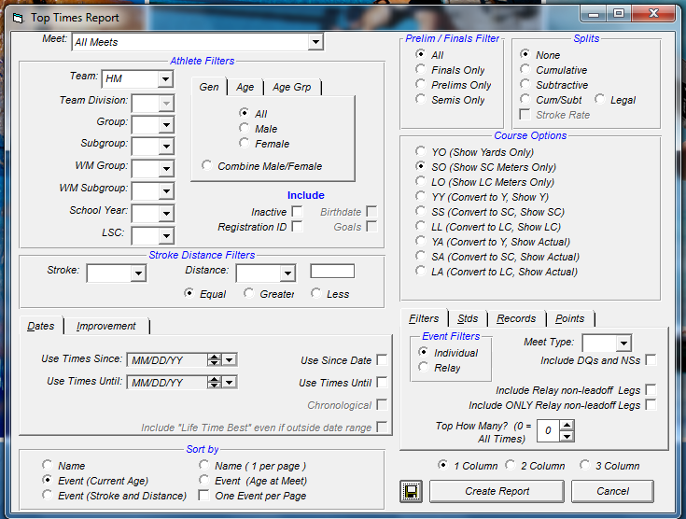
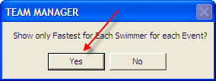
Generate Ladder Reports in TM
Reports | Performance | Top Times
If want times converted from yards
Can use to show multiple teams
Can use to show only most recent times
Notes:
Memorize button…

Slide 76
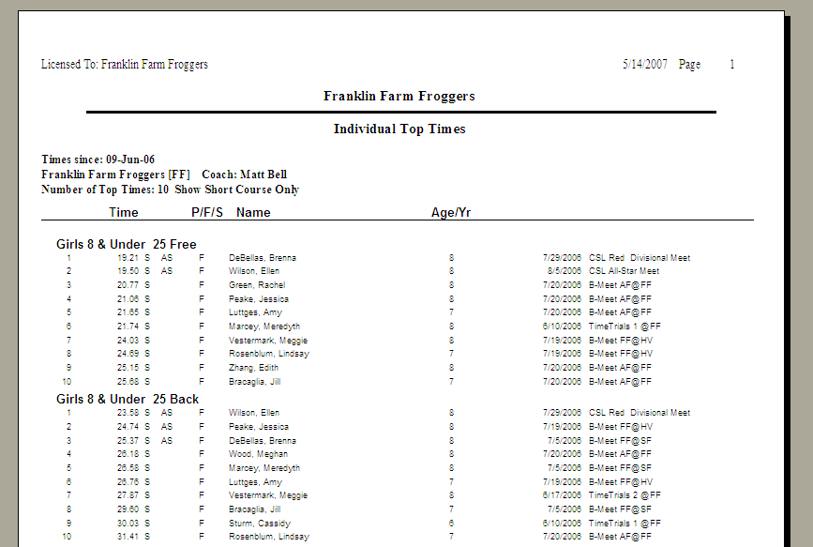
Team Ladders

Slide 77
Post-Meet Activities
HOT TIPS
Import data from DDC for ALL teams in your division, including your meet (because DDC performs checks)
Run records check but do NOT auto-update records; update manually instead
Generate dual ladders for next meet using Local Swim Club designator (Tip 07 in the Tips folder)

Slide 78
Final HOT TIPS
  Don’t struggle – ask for help
  Follow the instructions
  Backup, backup, backup: both team and meet
  Use recommended file name format/location
  Be sure you’re accessing the right meet
  Be attentive to team abbreviations
  Run *all* the verification reports

